Slide 1
Secure Website/Data Acquisition Calendar
Diane Winn
Public School Finance/Financial Specialist

Slide 2
WING FTP SERVER
(Secure File Transfer Protocol)
Shows Foundation Support Documents by year
Includes supporting documents for Foundation payments made in February, May and July
Contact for passwords and access:
  Diane Winn
    dwinn@sde.idaho.gov
    208-332-6845

Slide 3
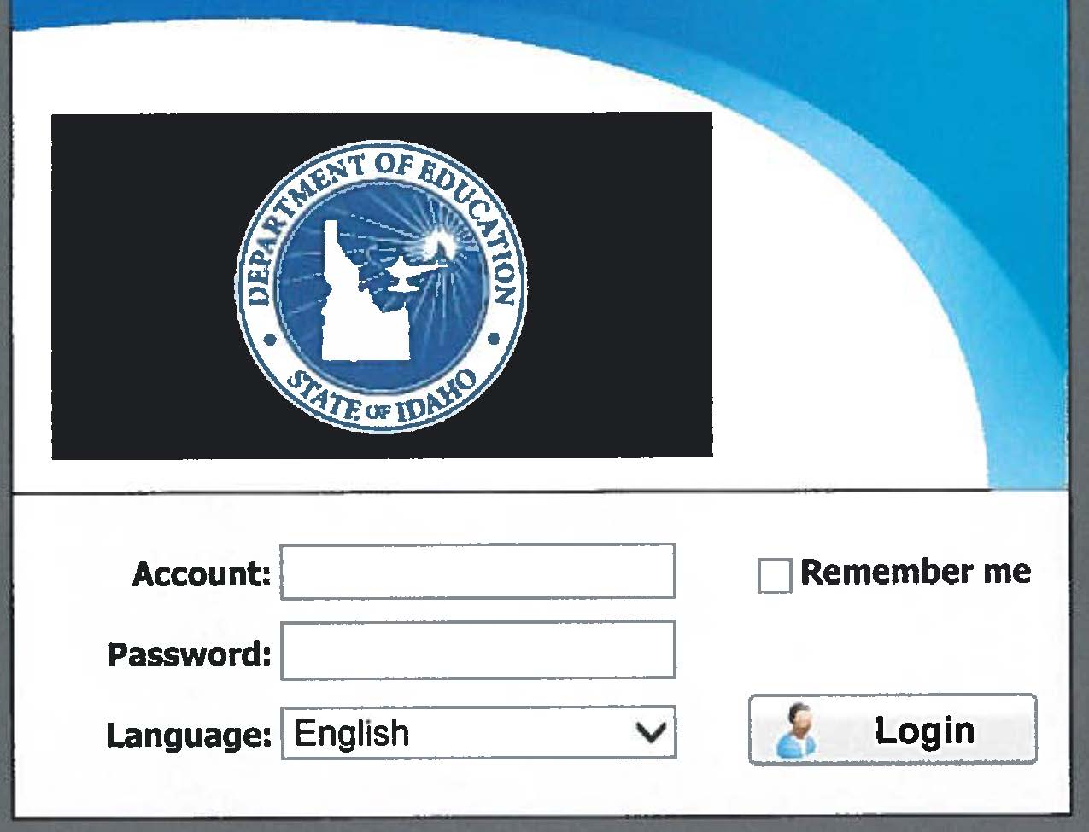
WING FTP SERVER
Located at: https://sftp.sde.idaho.gov/
Supporting documents for Public School Finance
The password is only provided to Superintendents and Charter School Administrators
Enter your 4 digit Account code and Finance password

Slide 4
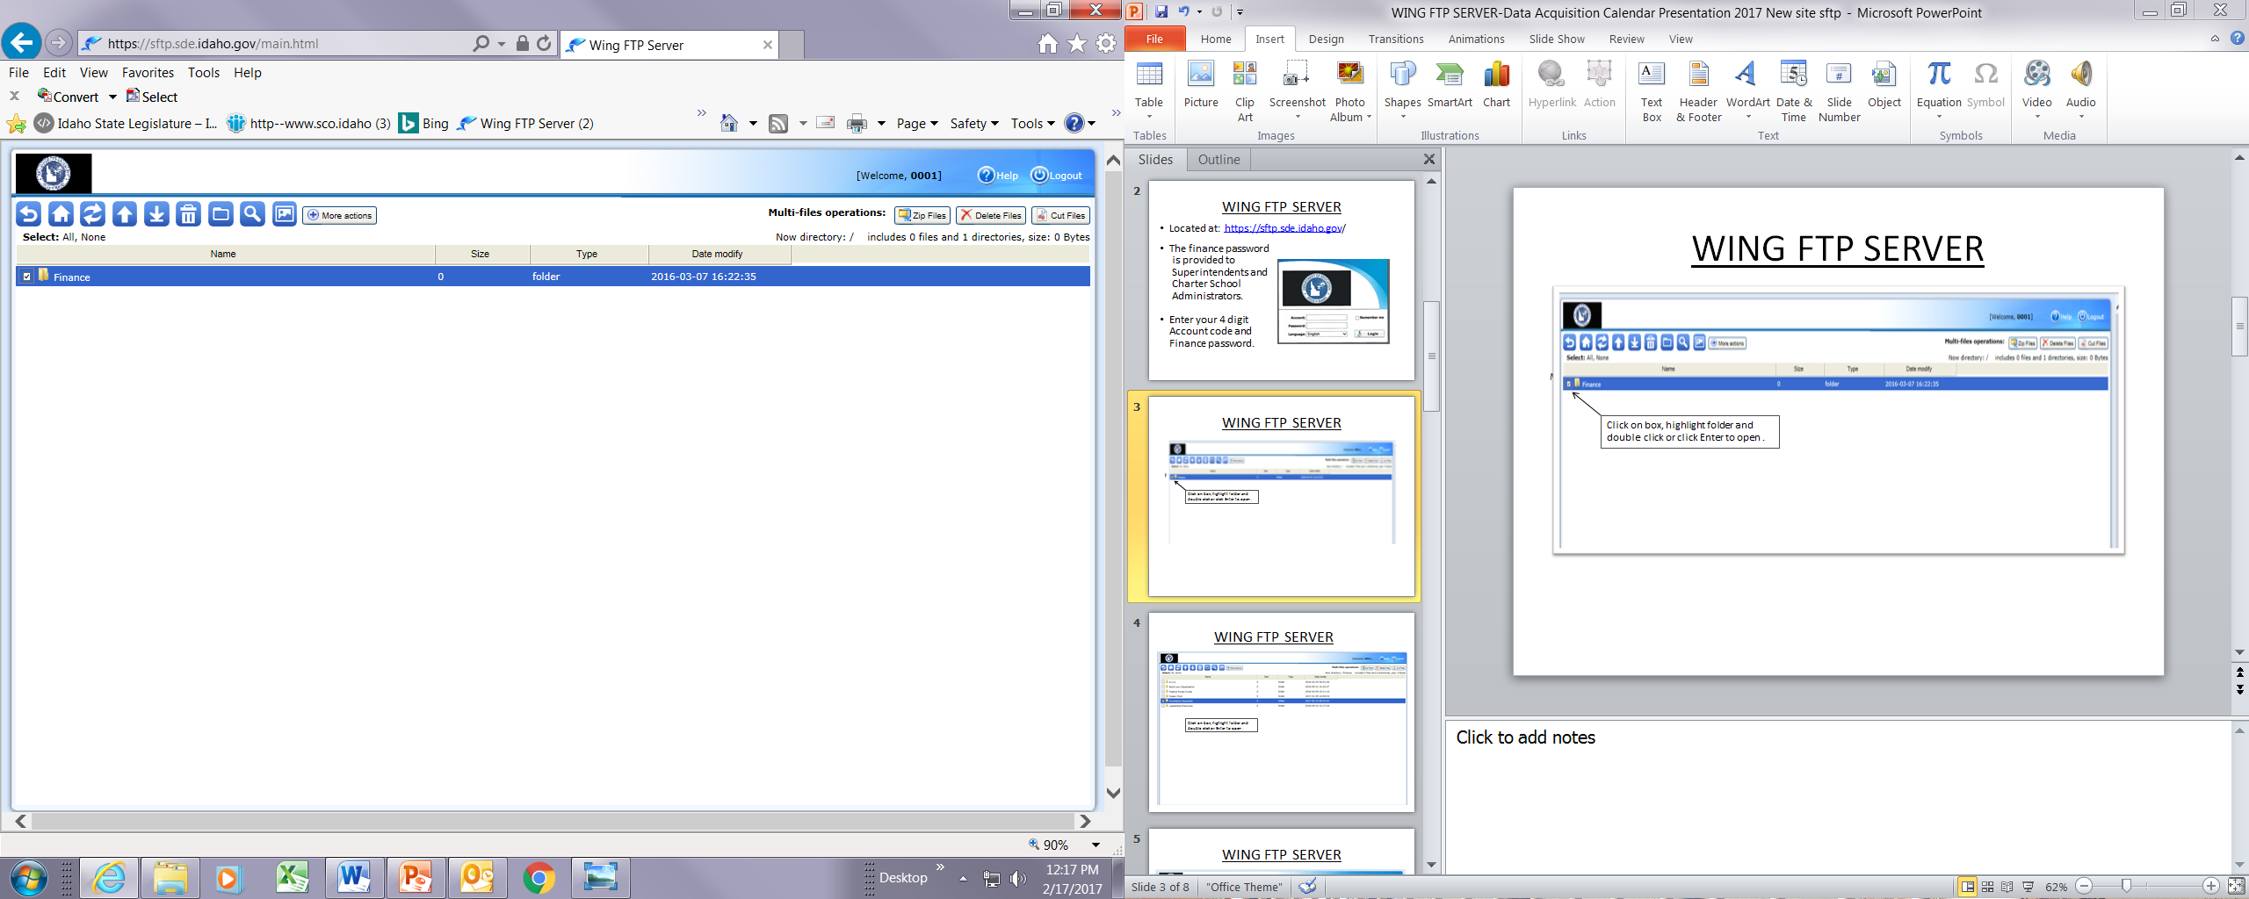
Main Page
Double Click on Finance folder or Check box, highlight folder and
double click to open
Secure Website | 4

Slide 5
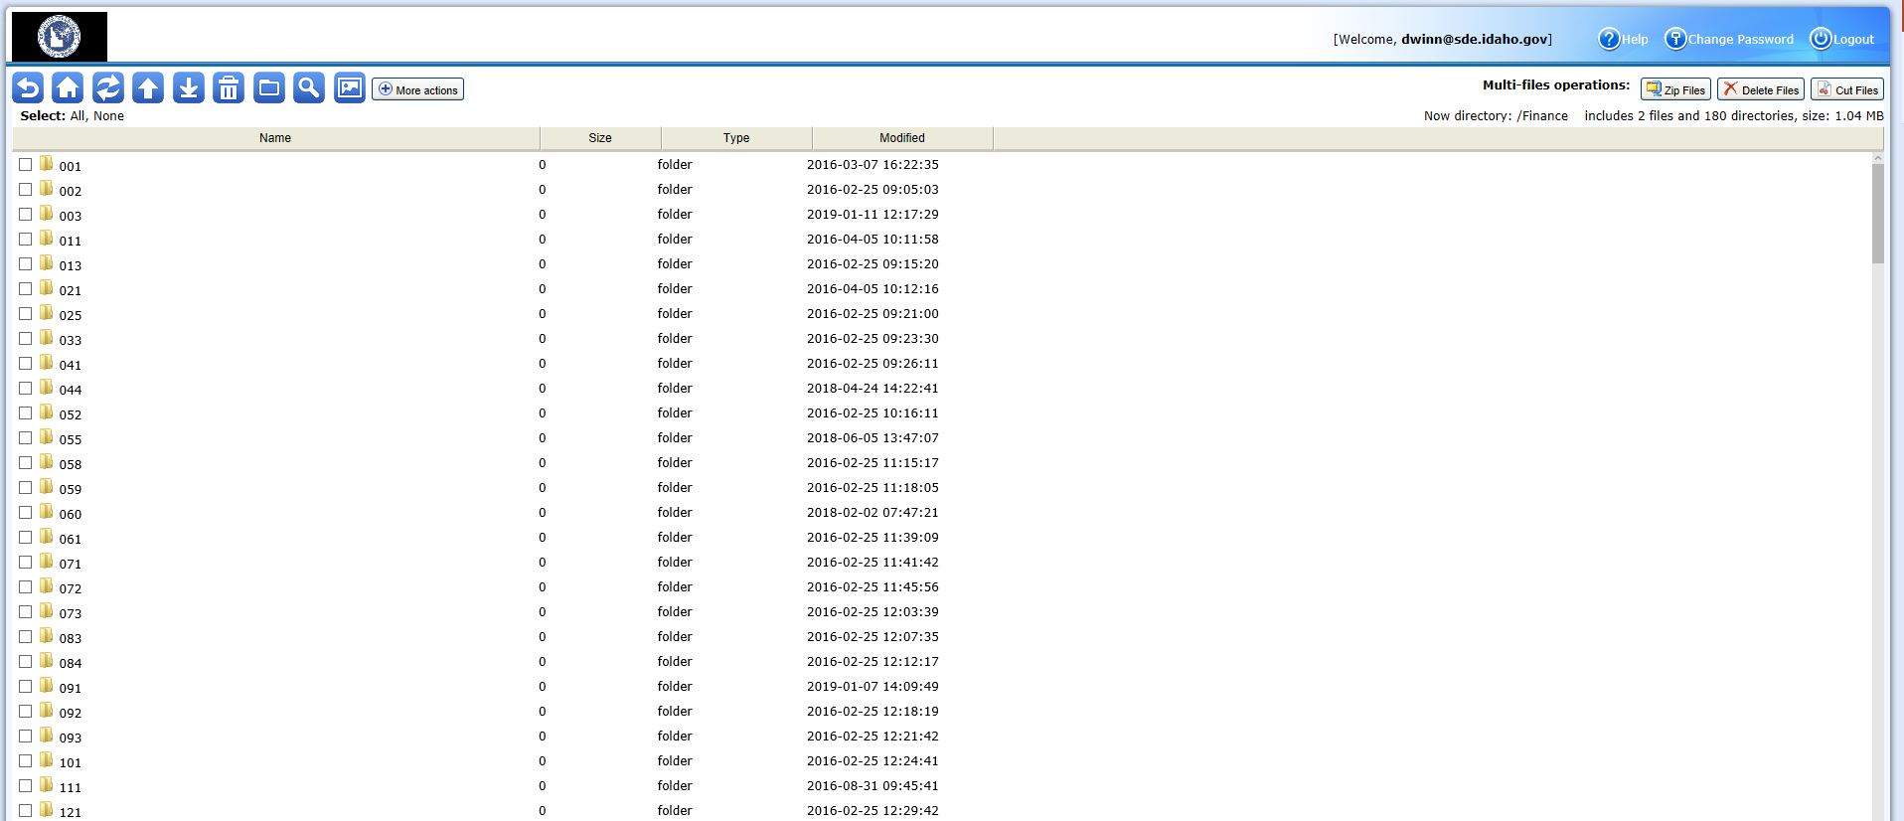
School District/Charter School
Double click on School District or Charter School Number. Your Number will be the only one that shows up in folder

Slide 6
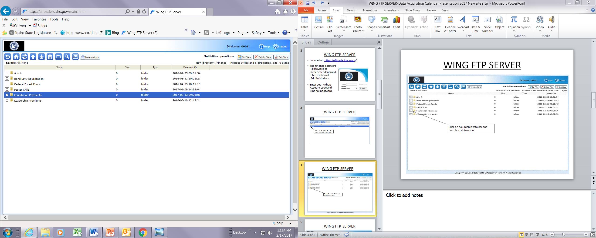
Finance Page
To open, check the box, highlight and press enter

Slide 7
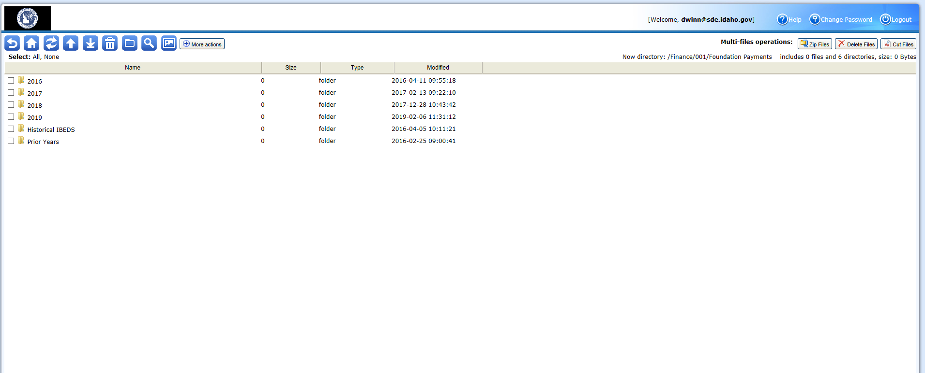
Foundation Payment Page

Slide 8
Data Acquisition Calendar

Slide 9

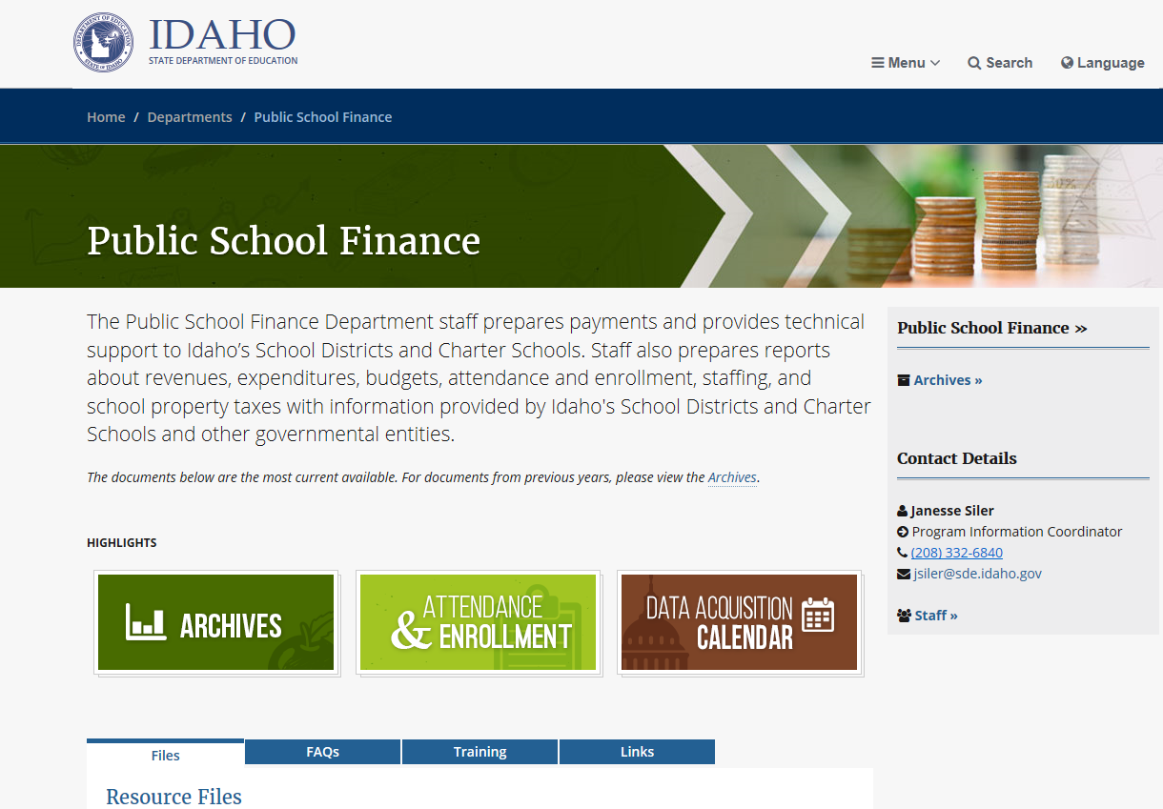
Website http:sde.idaho.gov scroll down and select PSF box
Click to open

Slide 10
Data Acquisition Calendar (Cont.)
Calendar by month of reports due to the SDE as required by federal and state regulations
Updated calendar available on SDE website by July 1st of each year
Updated during year as adjustments are made

Slide 11
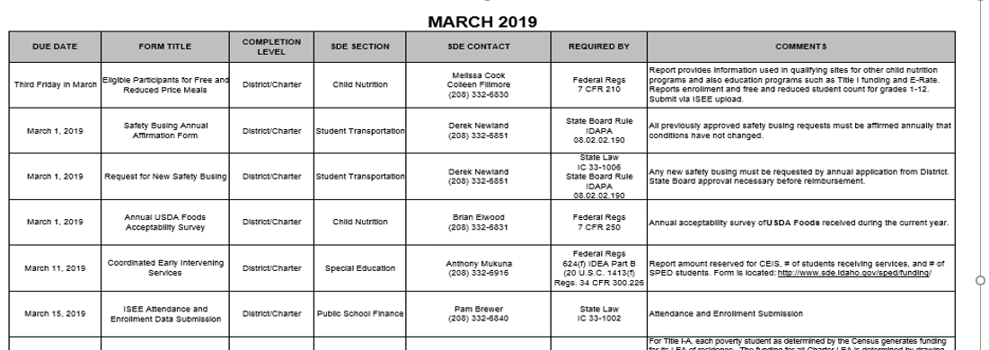
Example Month

Slide 12
Questions?
Diane Winn | Financial Specialist
Idaho State Department of Education
650 W State Street, Boise, ID 83702
208 332 6840
DWINN@sde.idaho.gov
www.sde.idaho.gov/finance

