Slide 1
Attendance and Enrollment
Pam Brewer
Public School Finance – Financial Specialist, Senior

Slide 2
Funding Basics
Approximately 90% of your funding is based on student attendance
Nearly 80-85% of your expenditures will be salaries and benefits

Slide 3
School Funding
Enrollment drives attendance
ADA (Average Daily Attendance) = Support Units
  One Unit is approximately one classroom
Units drive funding
  The majority of your State funding is based on Midterm Reporting Period information:
      First day of school to/including first Friday in November
        Important Note: Students added after the first Friday in November will not be included in the majority of your funding. Subsequent uploads (March, May, June) will not change the Units unless the Midterm information changes.
      Salary Benefit Apportionment Calculation is based on these Units from the Midterm timeframe
Discretionary – Operational Funding
  Best 28 weeks – This July payment does include students enrolled throughout the year however it does not change your SBA Units unless you grow significantly. (IC 33-1004).

Slide 4
What is a Support Unit?
The ADA divided by a Divisor = Support Unit
  Unit Calculation Table (IC 33-1002)
    A divisor takes the size of the District/Charter (ADA) per grade grouping into consideration:
      Kindergarten
      Elementary (1-6)
      Secondary (7-12)
        Note: Charter Schools - Idaho Code 33-5208 is used if there is less than 100 ADA, the divisor is 12
      Exceptional Child
      Alternative
  Minimum Units are used for equalization
    Helpful if you grow 1-2 students and your divisor changes, keeps your funding stable.

Slide 5
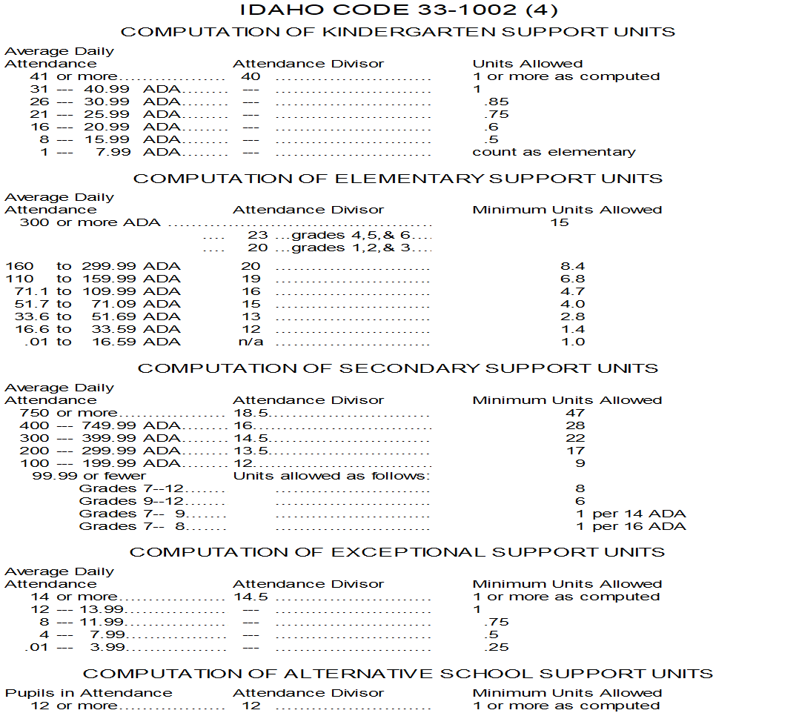
Unit Divisor Table (33-1002)

Slide 6
Attendance
Aggregate Attendance: the total number of students physically present
ADA (Average Daily Attendance):
  “…aggregate number of days enrolled students are present, divided by the number of days of school in the reporting period” (IC 33-1001)
No student shall generate more than one (1) ADA

Slide 7
Average Daily Attendance
Students are identified with an EDUID number, assigned to a calendar and counted when in attendance.
  Students dually enrolled and generating more than one (1) ADA will automatically be adjusted to one.
  Alternative school ADA is funded based on 25 hours
    Those students who exceed 25 hours will be automatically adjusted to one ADA (however you may offer as many hours as needed)

Slide 8
A Day in Session
Kindergarten and Grades 1-12:
  Less than 2.5 hours per day = zero day of attendance
  2.5 hours to less than 4 hours = half (.5) day of attendance
  4 hours or more = full (1.0) day of attendance
Note: A Kindergarten class is funded at approximately half of an elementary class.
“Day in Session”
A school day may be counted as a “day in session” when the school is open and students are present and under the guidance and direction of teachers in the teaching process. Lunch periods, breaks, passing time and recess will not be included. (IDAPA 08.02.01)

Slide 9
Calendars
Two types of Calendars are reported to the SDE:
  Instructional – hours of classroom instruction based on grade levels (IC 33-512)
  ISEE (Idaho System for Educational Excellence) student attendance
    Kindergarten
    Elementary (1-6)
    Secondary (7-12)
ISEE Calendars drive funding
  Enrollment tracking
  Attendance accounting
  Support Unit Calculation

Slide 10
Accurate Reporting
Calendars
  Setting Calendars
    Check for low days of attendance based on your district/charter history
  Calendar Types:
    Students must be attached to the correct calendar:
      K = Kindergarten (recorded in days – full and half)
      R = Regular school (including JDC) (recorded in days – full and half)
      A = Alternative school (recorded in hours)
      DR = Non-public student coming for a class or two (recorded in hours)
      SA = Summer Alternative school (approval needed) ( recorded in hours)
      SR = Summer Juvenile Detention (recorded in days – full and half)
  Grade Groupings
    Each grade grouping should attend the same days to maximize funding
      Kindergarten
      Elementary 1-6
      Secondary 7-12
  Attendance
    Record accurately
    Verify your data after each ISEE upload to your information

Slide 11
Kindergarten Calendar
Kindergarten Numbering System:
  1 = AM only (every day)
  2 = PM only (every day)
  3 = MWF (week 1) T Th (week 2) (two sessions per day)
  4 = MW every other F (two sessions per day)
  5 = T Th every other F (two sessions per day)
  6 = AM & PM (full day) every day
  7 and above = all other schedules
A separate calendar must be assigned in ISEE for each schedule within a building. Do NOT combine students who are attending different schedules on one calendar.

Slide 12
Kindergarten Funding
Kindergarten students are funded at approximately half of Elementary students.
  Kindergarten:
    3282 (agg hours) / 31 (days in session) = 105.87 (ADA) / 40 = 2.65 units
  Elementary:
    3282 (agg hours) / 31 (days in session) = 105.87 (ADA) / 16 = 6.62 units
Depending on whether a District/Charter chooses to offer half day schedules or full day schedules, the funding is the same:
    Half Day Kindergarten:
      1024 (agg hours) / 16 (days in session) = 64 (ADA) / 40 = 1.6 units
    Full Day Kindergarten:
      2048 (agg hours) / 32 (days in session) = 64 (ADA) / 40 = 1.6 units

Slide 13
Attendance and ISEE
We gather information through ISEE uploads during the months of:
  September (summer), October, November, December (new), March, May, and June
We use the following files for Attendance and Enrollment:
  District Calendar
    Includes the different types of calendars, grade groups, days in session and emergency closures
  Student Daily Attendance
    EDUID of each student and their attendance – attached to calendars and buildings
  Student Demographics
    Includes specific information about each student enrolled. We use grade levels, the district/charter the student is attending, the building they are attached to, if they are non-public students, if they are border students and the exit/entry dates.

Slide 14
Attendance – additional
Homebound students
Dual enrolled – Publicly enrolled
Dual enrolled – Non-public students
Alternative schools/IDLA attendance
Juvenile Detention attendance
Emergency Closures
Early Graduates
Foreign Students attending districts/charters

Slide 15
Homebound students
A homebound student is one that would normally attend school but due to an illness or accident is unable to attend.
IC33-1003A – For illness or accident that necessitates an absence from school for more than ten (10) consecutive days, the school district may include homebound students in its total attendance, provided that academic instruction has been given by appropriate certified professional staff employed by the district.
  Typical reasons are medical and/or doctor driven
Note: Beginning on the eleventh (11) day and thereafter, the student may be included in the total aggregate attendance.
  Books and assignments are sent home and the district will report the student in full attendance until they are released by the doctor and return to school.

Slide 16
Dual Enrolled – Publicly enrolled students
A public dual enrolled student is any student attending more than one traditional public school, public charter school, or public virtual school.
  Based on how the two public schools report the attendance, the ADA will be split accordingly in the system. If there is a disagreement on the split, it is up to the two public schools to work out how the ADA will be divided or set up a tuition agreement.
    You must use a R (regular) calendar and report attendance in .5 or 1.0 following the rules of daily attendance. Please note that a student must be in attendance at least 2.5 hours a day to register ADA.
  It is important to exit the student on their last day of attendance.
Reminder: No student shall generate more than one (1) ADA.
ISEE reports: Allocated Enrollment and the Greater than 1 ADA report allow each district/charter to identify these students by their EDUID assignments, enrollment and attendance. Please review these reports prior to the correction deadlines to find any issues and problems with sharing ADA.

Slide 17
Dual Enrolled – Non-publicly enrolled students
Students educated in other than public schools, and who attend classes at a public school, public charter school or public virtual school are considered dually enrolled students.
  These students must attend at least two and one half (2.5) hours per week to be included in the aggregate attendance.
There are two options for reporting:
  Attach students to a dual enrolled (DR) calendar. The time is reported in hours rather than half or full days. In the student demographics file the student must be assigned a grade level and identified as follows:
      H = Home schooled
      P = Private schooled
      X = Not PH schooled
  Manually add the student’s attendance to the attendance file (Reg calendar) based on this formula:
    Total minutes of attendance X days attended (55 x 5 = 275)
    Total hours of attendance divided by 60 (275/60 = 4.58)
    Aggregate hours of attendance divided by 4 (4.58/4 = 1.15 (round to 1.0))
Note: Be careful when identifying students as non-public versus students enrolled in another public district, charter or virtual charter.

Slide 18
Alternative and IDLA
Alternative schools:
  Calendar type = A - attendance is reported in hours and calendars and attendance must show maximum instructional hours for the day. Full time equivalent is based on 25 hours a week.
IDLA (Idaho Digital Learning Academy):
  Regular students: add and include these in daily attendance
  Non-publicly enrolled students: use a DR calendar and follow the directions for DR calendars.

Slide 19
Detention Center Attendance
There are 12 recognized Juvenile Detention Centers in Idaho
  The approved JDC will report attendance on students placed in these facilities while the students are under the instruction and guidance of a certified teacher.
  The home district/charter will NOT record attendance.

Slide 20
Emergency Closures and Waivers
“When a school is closed, or if a school remains open but attendance is significantly reduced because of storm, flood, failure of the heating plant, loss or damage to the school building, quarantine or order of any city, county or state health agency, or for reason believed by the board of trustees to be in the best interest for the health, safety or welfare of the pupils…” the ADA shall be considered as being the same as for the days when the school was open (IC 33-1003A).
Not recognized as an Emergency closure:
  Teacher strike or the withholding of service
  Funeral services
  State tournaments
  Construction delays

Slide 21
Emergency Closure Form

Slide 22
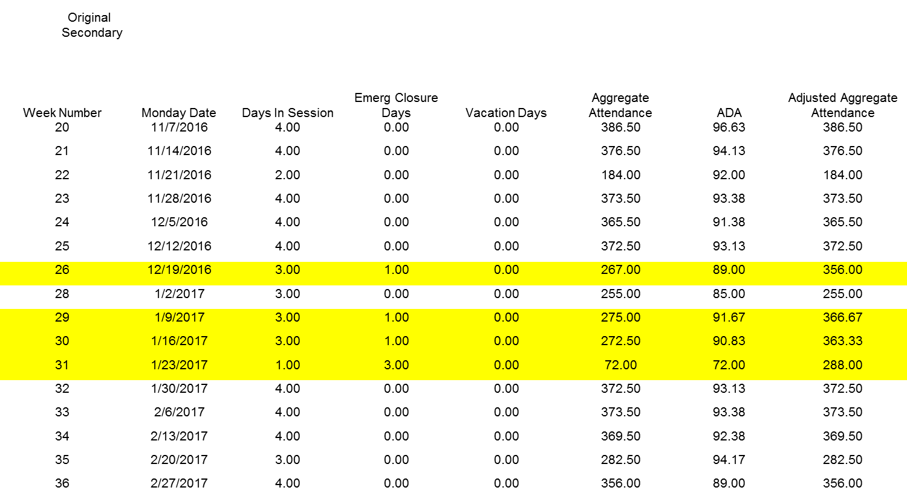
Emergency Closure - Original Building Report

Slide 23
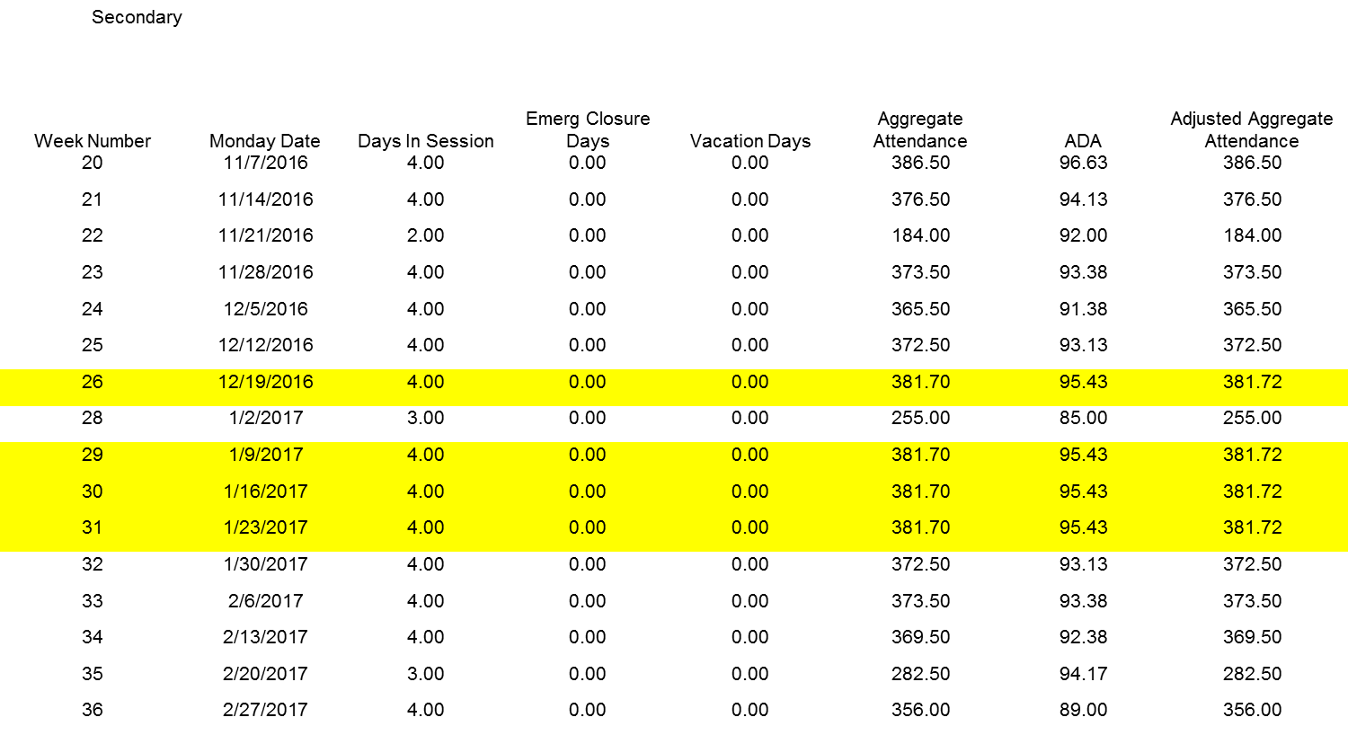
Emergency Closure - New Building Report

Slide 24
Impacted attendance – Original Building Report

Slide 25
Impacted attendance – New Building Report

Slide 26
Early Graduates
Continue to report attendance for high school senior students who graduate early.
  Students who graduate mid-school year of their senior year (granted permission)
Create attendance records based on the first semester (usually not 100%). Use course code 86000 and exit them at the end of the years as a regular student.

Slide 27
Other Early Graduates
Students (juniors) that complete their 1-12 curriculum early and have an exit code of 4G Early Graduation 1 year assigned, are eligible for an advanced opportunities scholarship however their attendance cannot be included for a senior year.
Students (juniors) that complete their 1-12 curriculum early and are taking advantage of advanced opportunities with dual-credit courses (college courses) can be included in the attendance roles, as they are still seniors.

Slide 28
Foreign Students and Attendance
  F-1 Visa – onVisa is marked and excluded from ADA.
    F-1 students can only attend schools that have a SEVP certification with the Department of Homeland Security (DHS). These students are self-sponsored.
    F-1 students are issued a Form I-20
  J-1 Visa is for exchange visitors, including, but not limited to, foreign exchange students. These students have a sponsor and receive ADA.
    Foreign exchange students are identified in ISEE by their exit and entry codes:
        4A Foreign exchange entering
        5F Foreign exchange exiting

Slide 29
ISEE Balancing Reports
Because enrollment and ADA drive funding through units, it is important to review the ISEE data for accuracy. The most current information in these reports will be available approximately 1-2 days after each upload.
  The following reports will help:
    Current Year Support Unit Calculation
    Building Report
    District Wide
    Net Enrollment Report
    Aggregated Attendance Detail Report
    Allocated Enrollment
    Greater than One ADA
    Best 28 (end of the year)

Slide 30
Accessing reports from the SDE

Slide 31

Idaho State Board of Education Applications Portal

Slide 32
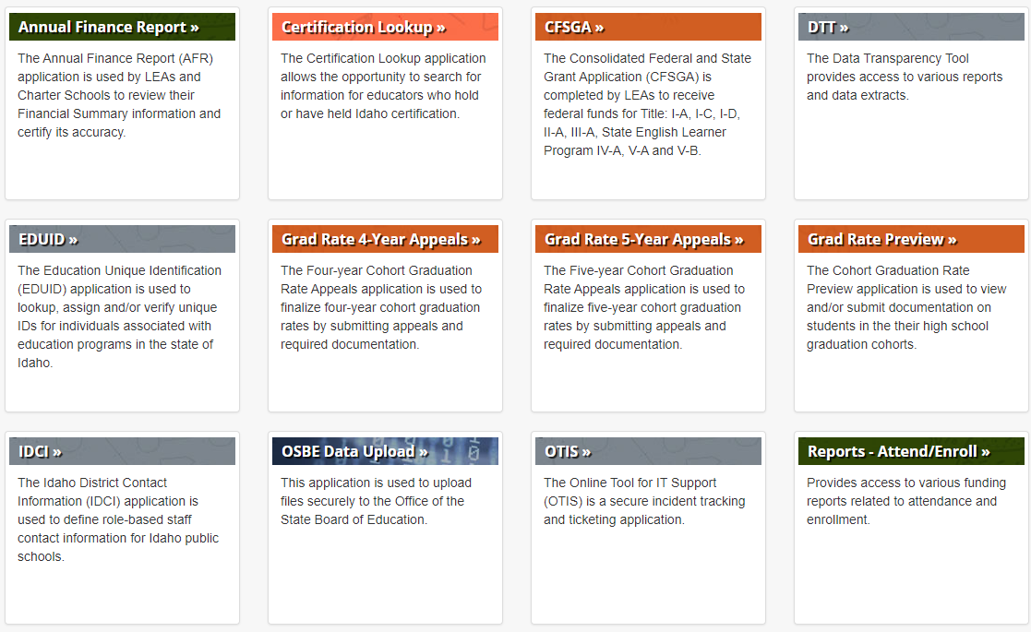
Reports – Attend/Enroll

Slide 33
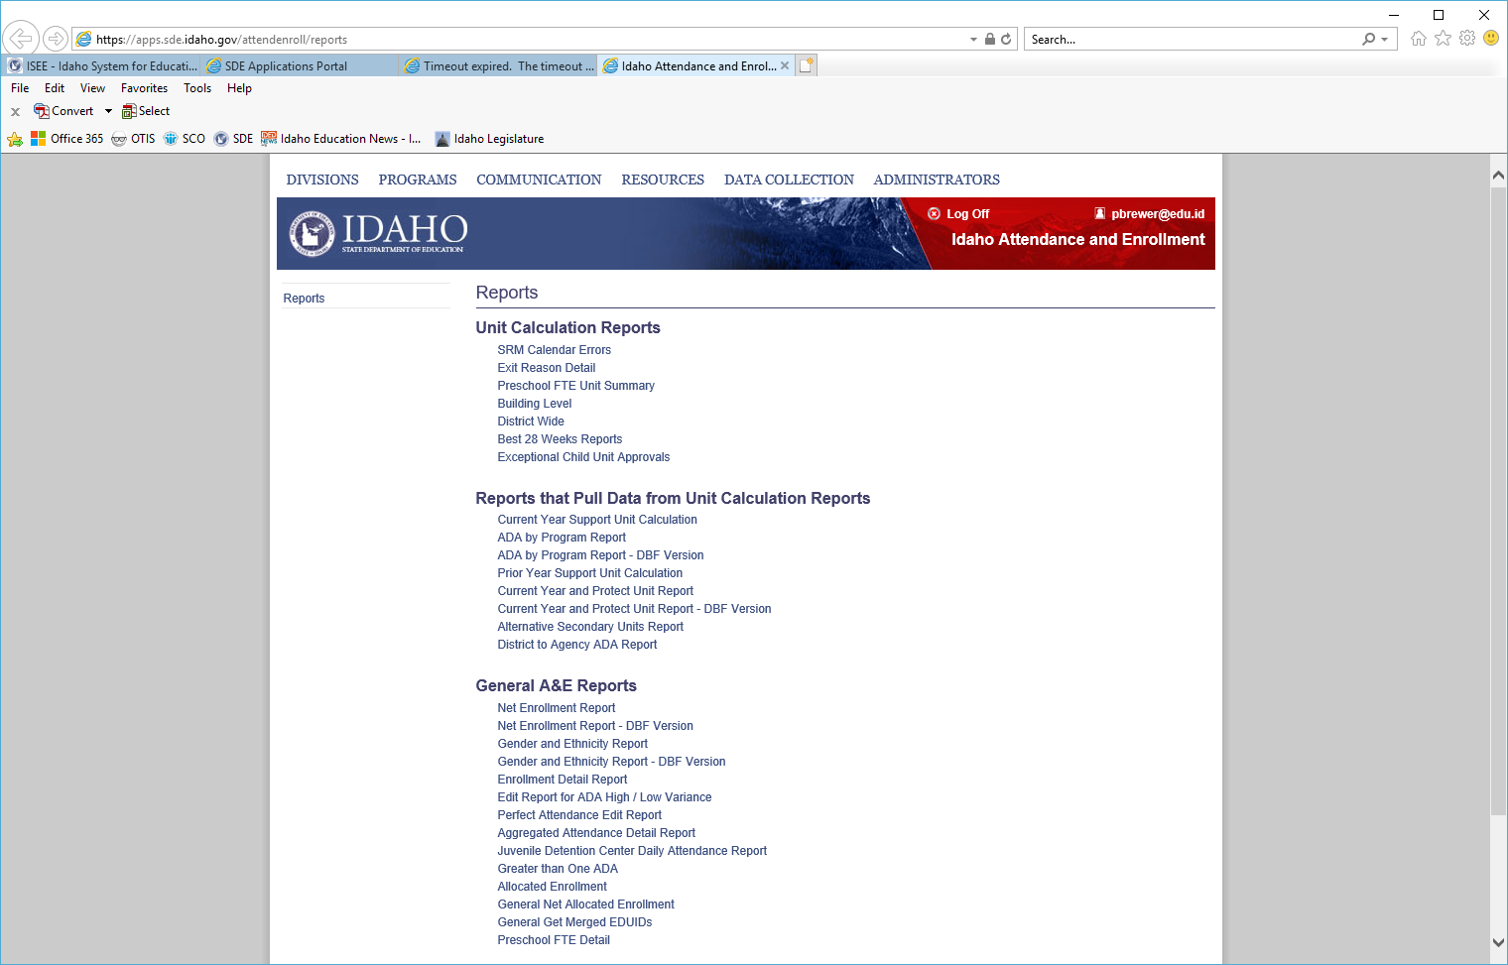
List of Reports

Slide 34
Current Year Support Unit
H

Slide 35
Current Year Support Unit with Tracks

Slide 36
ADA and Grade Grouping

Slide 37
Net Enrollment

Slide 38
Building Level
Low week of attendance compared to other “like” weeks

Slide 39
Aggregated Attendance Detail

Slide 40
Prior Year Support Unit
Notes:
Charters can fail or succeed – districts have protection per Idaho Code

Slide 41
Greater than 1 ADA Report
Maximum of 1 ADA is allowed per student
Public school students enrolled in more than one public school district/charter or public virtual school will be split per time they spend in each program provided they are in attendance at least 2.5 hours per day and are placed on a Regular calendar.
  If both parties agree with the allocated split, then nothing needs to be done. If they do not, negotiations will need to be made about tuition or adjusting attendance.

Slide 42
Greater than 1 ADA

Slide 43
Maximize Your Funding
Establish accurate calendars; look at historical data
Ensure that the calendar type is correct for each student
Integrate each grade group in the correct calendar
Double check entry and exit dates
Run Allocated Enrollment and Greater than 1 ADA reports to identify dual enrolled students
Send in submissions early to check data and make corrections by the deadlines
Have a designated person assigned to run attendance and enrollment reports within 2-3 business days after transmission
Attend workshops/roadshows

Slide 44
ISEE Submission Schedule 2020-2021

Slide 45
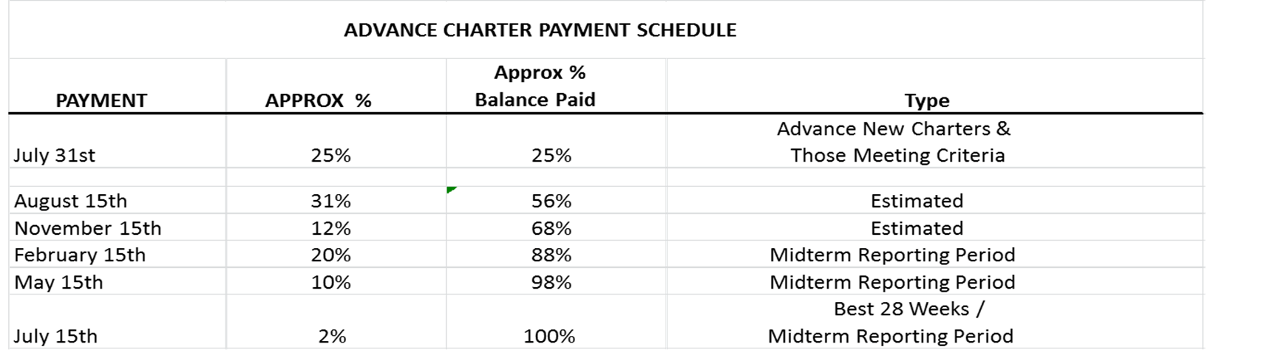
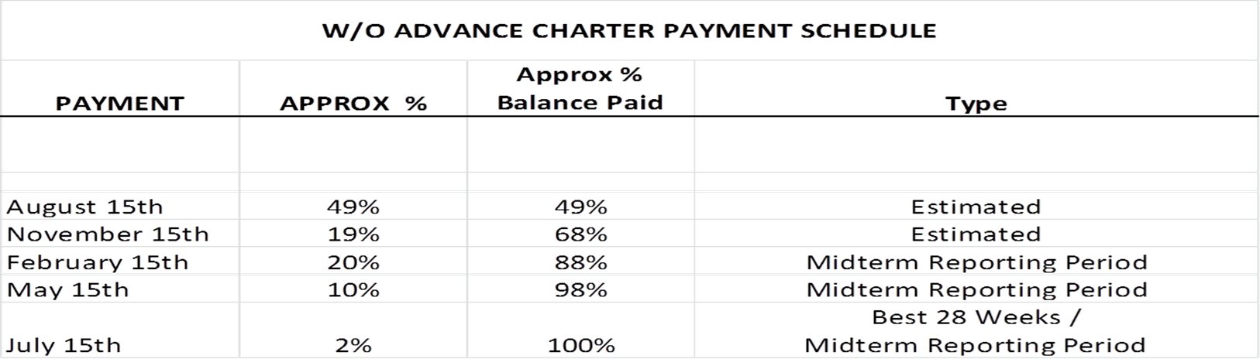
Payments and Accurate Reporting

Slide 46
Department of Education – School Finance
Contacts
Julie Oberle (Chief Financial Officer) jaoberle@sde.idaho.gov
Branwyn Phillips (Staffing) bphillips@sde.idaho.gov
Aaron McCoy (IFARMS) amccoy@sde.idaho.gov
Diane Winn (Financial Specialist) dwinn@sde.idaho.gov
Pam Brewer (Attendance) pbrewer@sde.idaho.gov
Carol Piranfar (Budgets) clpiranfar@sde.idaho.gov
Mandy Fulbright (Info Coordinator) mfulbright@sde.idaho.gov
Dani Wood (Info Coordinator) dwood@sde.Idaho.gov
Phone number: 208-322-6840
Web site:
Idaho State Department of Education, Public School Finance
State Department of Education

Slide 47
Questions?
Pam Brewer
Idaho State Department of Education
650 W State Street, Boise, ID 83702
208.332.6800
pbrewer@sde.idaho.gov
www.sde.idaho.gov

